Slide 1
Kecerdasan Buatan
Satria Damai Kurnia
Anthony Santoso
Yuan Pratama
26415172
26415108
26415163

Slide 2
Minimalistic Go MCTS Engine
Michi aims to be a minimalistic
but full-fledged
Computer Go program
based on state-of-art methods (Monte Carlo Tree Search)
and written in Python.

Slide 3
Go-Kill using Monte Carlo Alogarithm
The focus of Monte Carlo tree search is on the analysis of the most promising moves, expanding the search tree based on random sampling of the search space. The application of Monte Carlo tree search in games is based on many playouts.
In each playout, the game is played out to the very end by selecting moves at random. The final game result of each playout is then used to weight the nodes in the game tree so that better nodes are more likely to be chosen in future playouts.

Slide 4
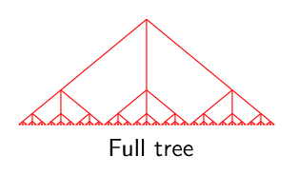
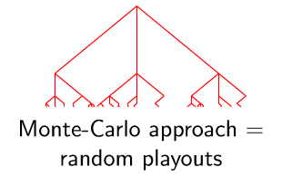
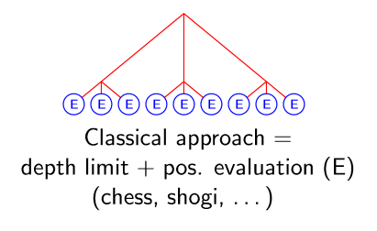

Slide 5
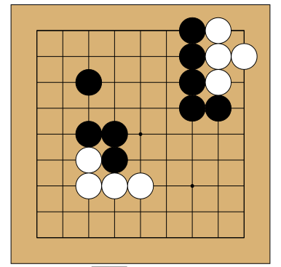
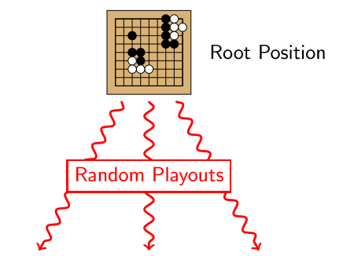
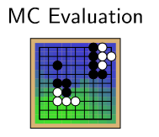
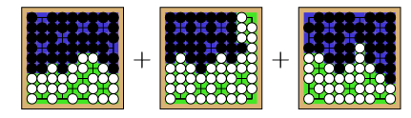

Slide 6
Behaviour Ai Go-kill
Ai never say pass the turn
If ai have no more way out then ai will random his step to the empty space on the board
Also our Ai method is try one by one (Monte Carlo) until the 1400 tries has passed

Slide 7
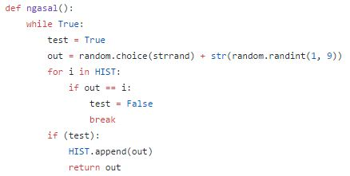

Slide 8
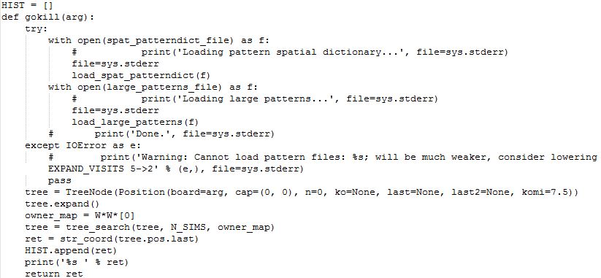

Slide 9
Our full Code
https://github.com/taezatria/KB-Her/tree/master/GO-Kill

Slide 10
Thanks To...
www.remi-coulom.fr/JFFoS/JFFoS.pdf
https://en.wikipedia.org/wiki/Monte_Carlo_tree_search
https://github.com/pasky/michi
https://github.com/pasky/pachi
https://github.com/waltheri/go-libraries
http://www.cosumi.net/play.html

